Slide 1
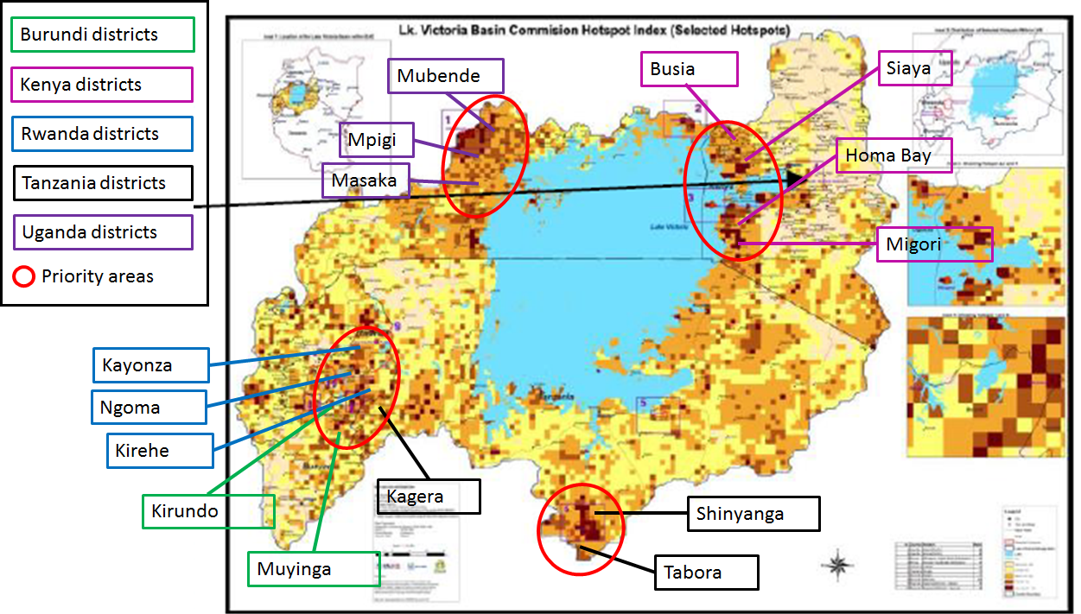
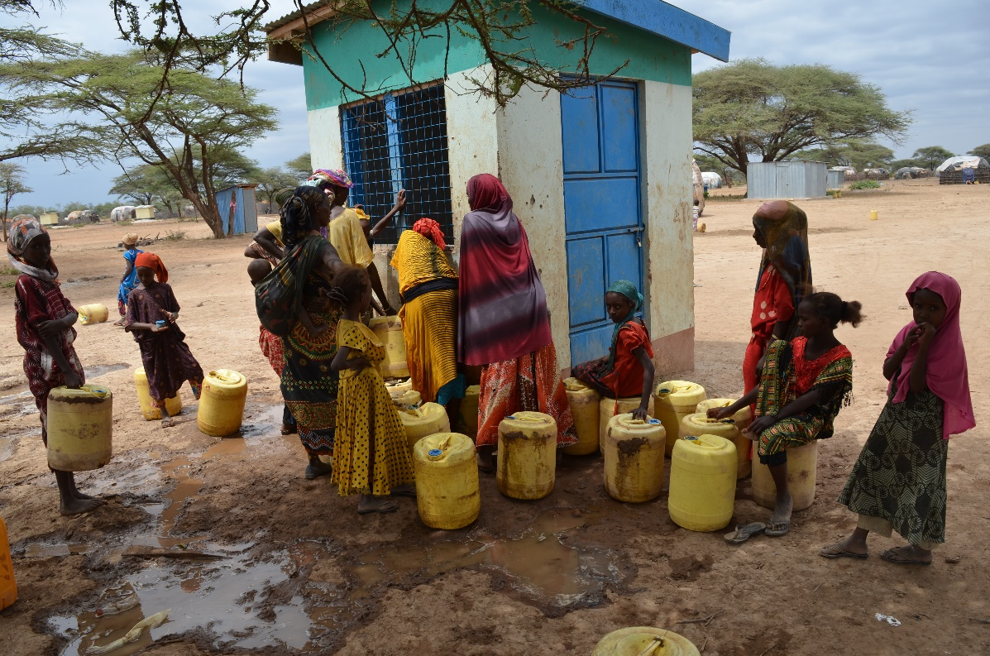
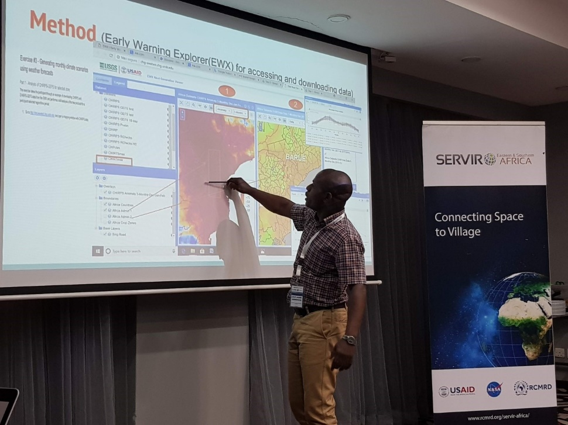
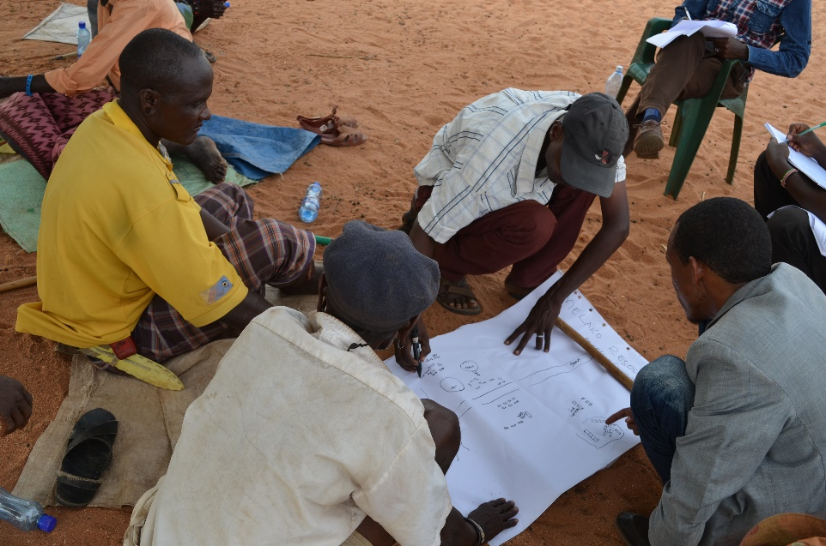
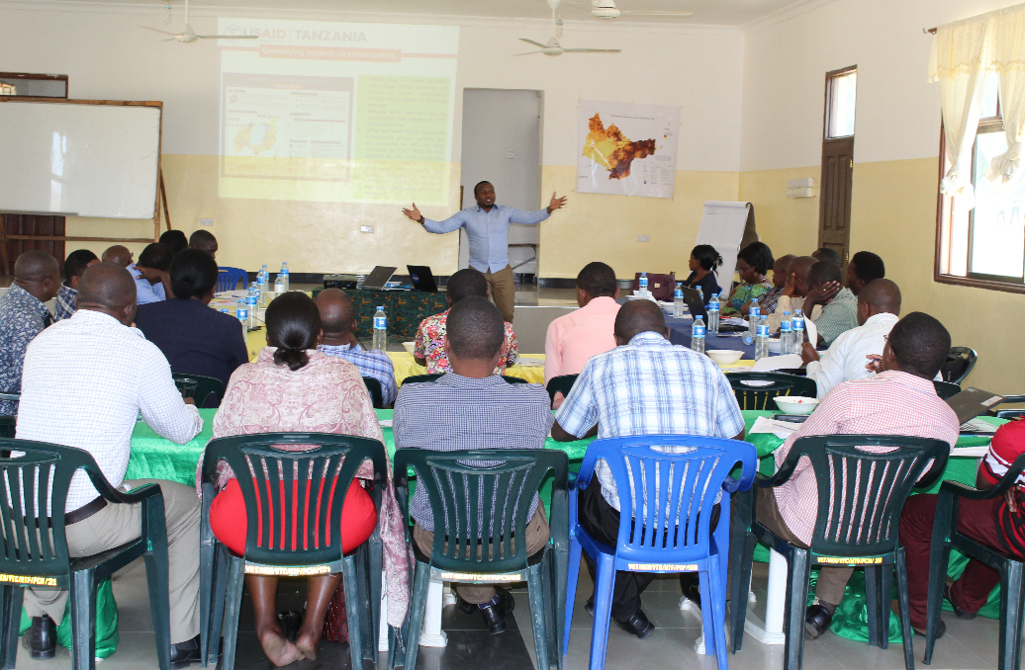
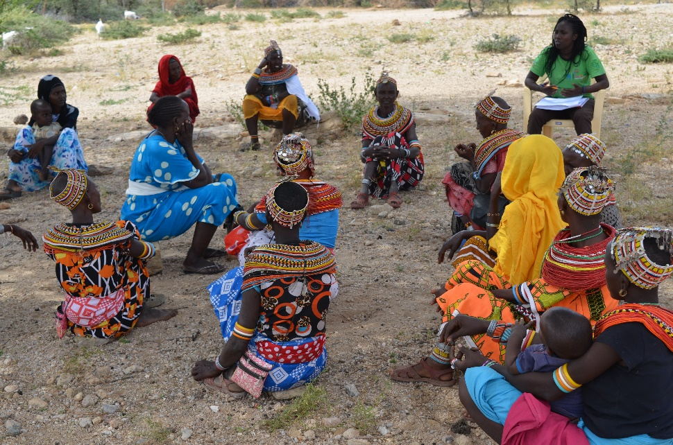
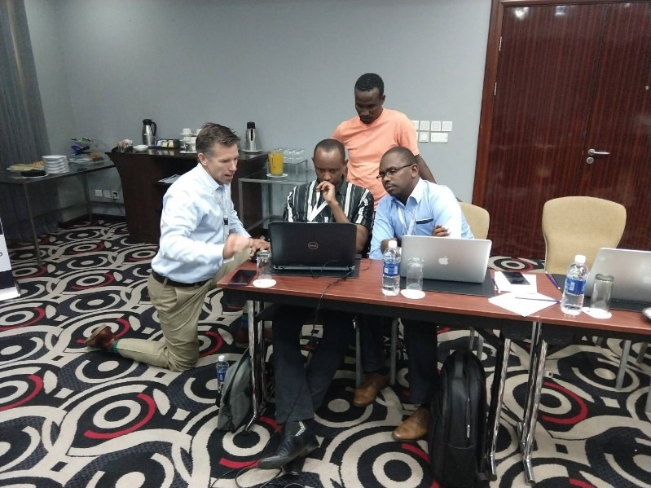
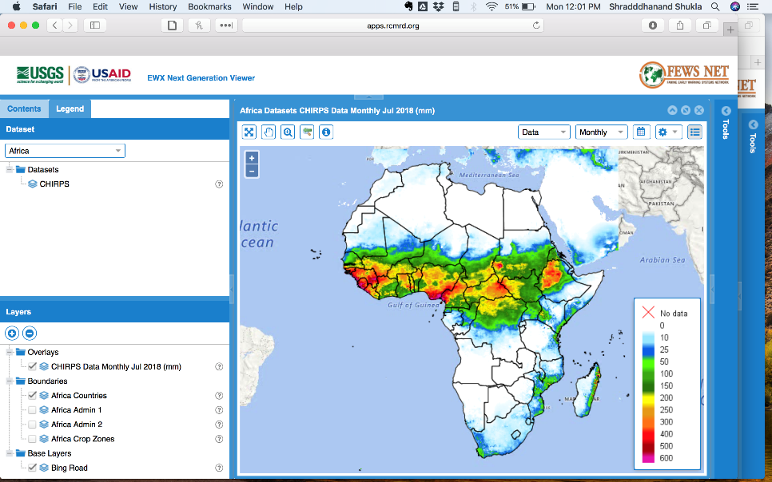
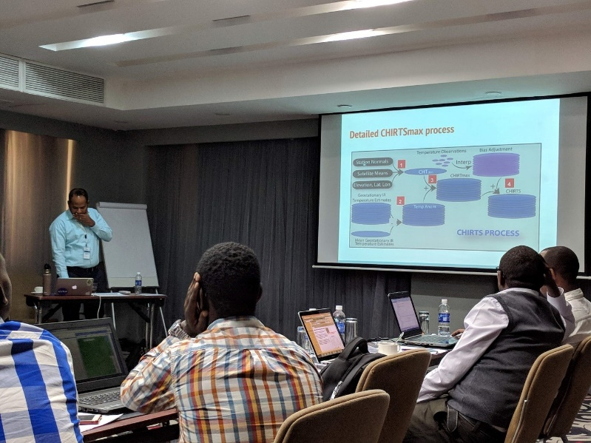
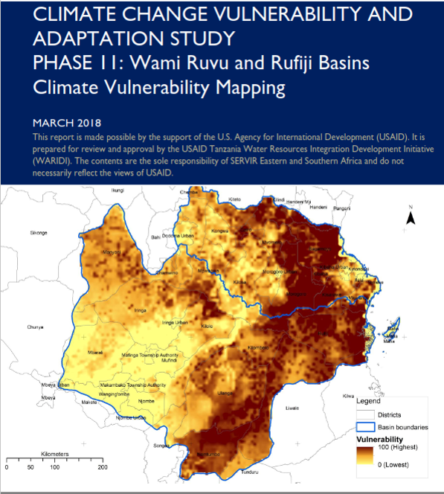
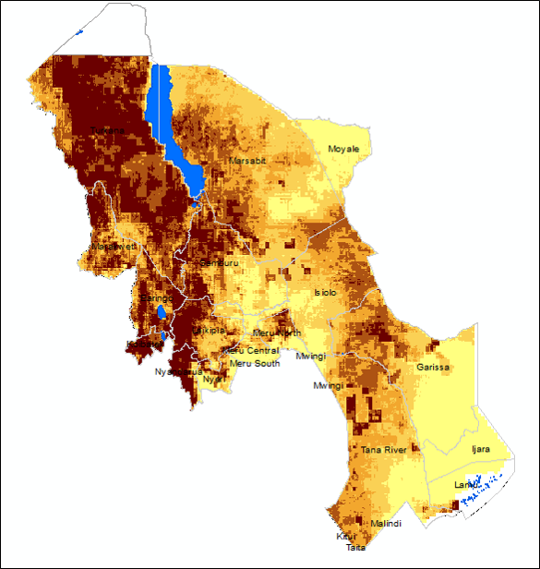
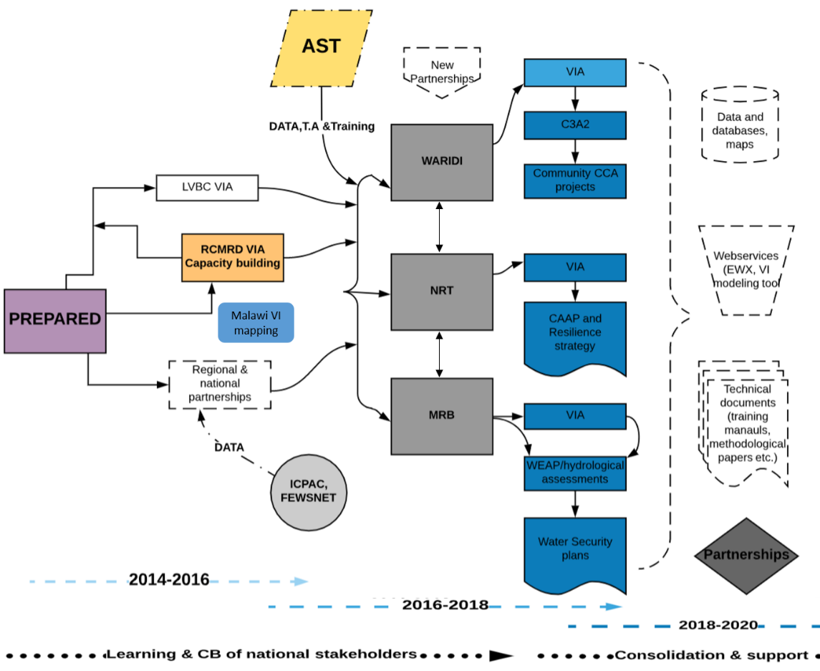
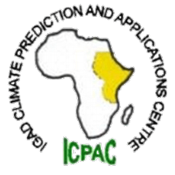
Enabling climate change adaptation for communities in East Africa through adaptation assessments and capacity building
Weather &
Climate
Training
Beta Testing
CAAP devpt.
Consultations
Fieldwork
Adaptation assessments
Needs Assessment
Stakeholder Mapping
Service Planning Dev.
Consultation/Needs Assess.
Vulnerability hotspot maps
Training national & local govt. agencies
Problem specification
Climate variability and change in the rangelands of Kenya and in major river basins in Tanzania is likely to significantly alter the functioning of the rangelands and their ability to support community livelihoods and biodiversity as well as the availability and quality of surface and groundwater resources. Vulnerability assessments have principally focused on assessing social vulnerability. Limited work has been carried out to understand the spatial exposure and sensitivity of differing ecosystems and communities to climate variability, their capacity and the ability of key institutions to anticipate, reduce, withstand and respond to climate-related impacts.
Use Case / Highlights
Service Use Case:
Selected Indicators / Metrics:
Theory of Change
To Achieve Sustainability
Assumptions: The need for this service will be existent throughout the service implementation period and key stakeholders and partners will continue to support the project
Inputs:
Outputs:
Vulnerability hotspots maps
Vulnerability mapping tool
Technical reports
Community adaptation projects
Resilience strategies
Outcomes:
Improved capacity of basin offices and water users in Wami Ruvu, Rufiji and Mara River Basins to implement integrated water resources management plans and communicate climate and disaster risks to basin users.
Improved capacity of Northern Rangelands Trust and key stakeholders to implement a climate and disaster resilience strategy for the Northern Rangelands.
Impact:
Reduced climate and disaster risk to water resources and livelihoods
“If it was not for your work (RCMRD/SERVIR-E&SA), we couldn't have received the funds. If we can implement more and show the impact clearly, then we can get more money” Fred Mngumbe, LVBC on receiving $5M from AF.
Data Acquisition, stakeholder consultations and training
Data processing & analysis, product co-development and validation
Products dissemination and integration into decision making processes
Goal
The overarching goal of this service is to work with co-implementing partners and decision makers in Tanzania and Kenya to apply and integrate climate exposure and vulnerability information in the development and application of resilience measures and strategies to reduce water risks, resource use conflicts, ecosystem degradation and loss of livelihoods.
Key stakeholders
Decision makers: NRT Conservancies managers, grazing coordinators, Wami-Ruvu, Rufiji and Mara River basin water boards, government ministries
Users: Meteorological services, water and irrigation agencies, basin water offices
Beneficiaries: Pastoralists, and basin water user groups (farmers, fishers, power generators, communities)
Special audiences: Women and girls, marginalized pastoral communities
“As a regional centre, it’s difficult for SADC-CSC to get regional precipitation datasets therefore CHIRPS is very useful” Sydney Samuel of SADC Climate Services Centre
Science Collaborations, Earth Observations, Models, and Methods
Contributions from AST
UCSB AST making Data and Web
services accessible to hub and regional
users
UCSB enabling use of data
& web services through
training
Beginning ARL: 3-4 Current ARL: 7 Final ARL: 9
Earth Observations / Models / Methods
Climate data: CHIRPS precipitation, CHIRTS temperature, CORDEX downscaled GCM
Environmental data: Vegetation, land cover, malaria susceptibility
Socio-economic data: Poverty, population access to water, health and market services, agricultural productivity, education, land use plans. Hazards data: Floods, droughts, wildfires
Immediate Next Steps
Developing a framework to expand the capabilities of the VI mapping tool to incorporate community adaptation perceptions
Consultations with FAO and UCSB on follow up training for agrometeorological officers in Tanzania Looking forward
>20 data layers produced
>30 national agencies trained
2 technical reports and 1 training manual produced
2 VI tools developed and applied in Kenya and Tanzania
>150 local government agencies officers trained in climate change adaptation
$5M mobilized by Lake Victoria Basin Commission from Adaptation Fund as a result of RCMRD/SERVIR E&SA support in VIA
Sustaining the VIA service by broadening demand base e.g., reaching out to USAID S.A
Transitioning the VI tool into a decision modeling tool (ongoing) by incorporating community perceptions
Supporting regional partners like LVBC, WARIDI, NRT and others implement community adaptation projects using outputs from VIAs
Community adaptation action plans developed for 14 NRT conservancies
Community adaptation projects to be rolled out in FY2019 for 20 ‘hotspot’ districts in Tanzania

