Slide 1
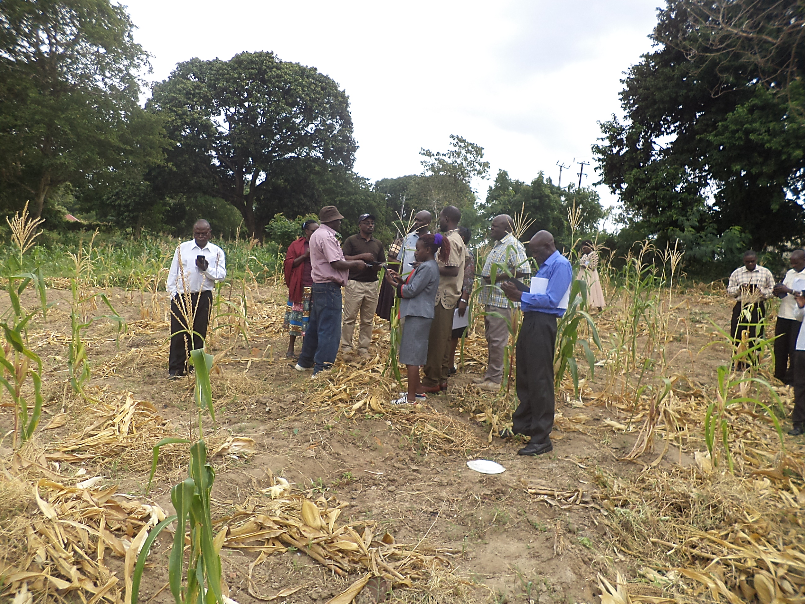
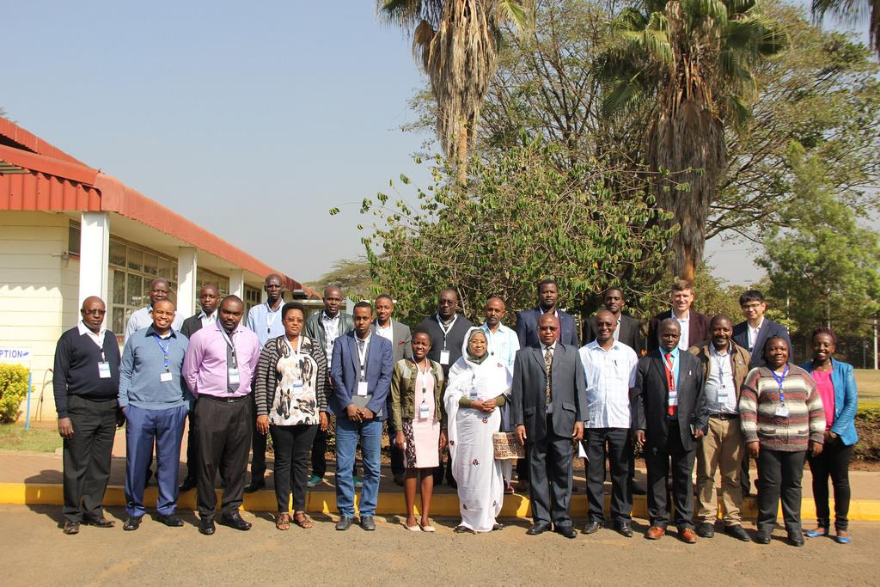
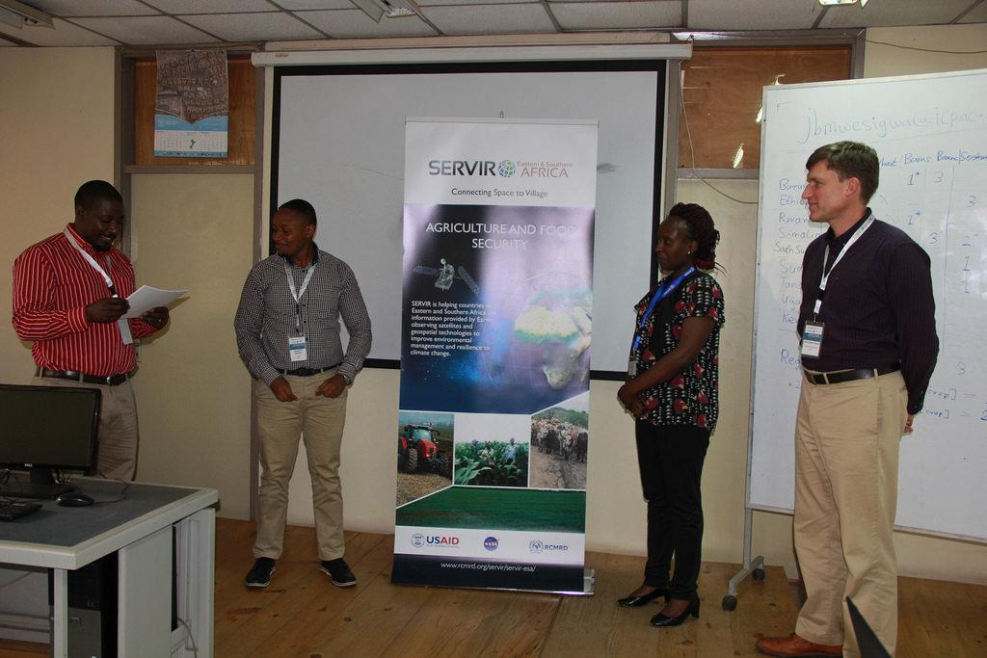
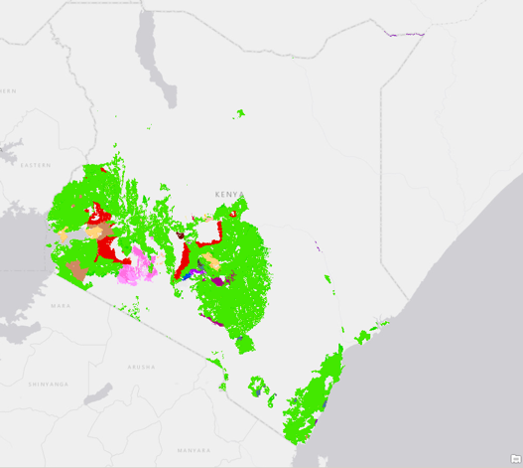
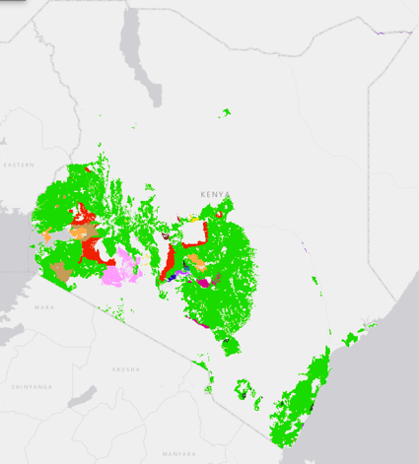
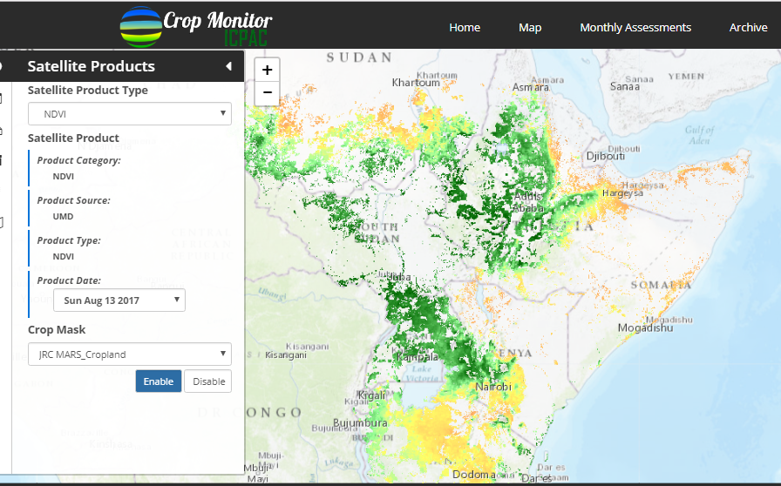
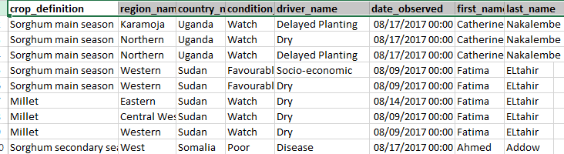
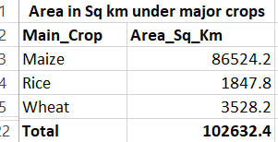
Agriculture and
Food Security
Regional Cropland Assessment and Monitoring
Problem specification
Climate variability coupled with over-reliance on rain-fed agricultural production on already strained land that is facing degradation and declining soil fertility; highly impacts food security in the Greater Horn of Africa region.This has led to low crop due to the influence of climatic conditions such as droughts and flood coupled with unpredictable rainfall; and changing temperatures which has resulted in poor yields. Lack of timely information, products and tools for decision making has been a major challenge in food security assessments and decision making.
Highlights
Service Tracker
(check completed items on tracker)
Developed cropland maps compute National level Agric. statistics for SDA and as an input to FEWSNET Crop models (GEOWRSI)
Piloted GIS sampling Frame resulted in 70% cost reduction from USD10000 to USD3000 per County. SDA is to provide partial financial support (approx. USD25000) in the upscaling the sampling frame to 20 counties
The Regional crop monitor’s First food security assessment report linking climate forecast to impact on food security to be included in the GHACOF quarterly bulletin
CNA/S
SC
PDD
TDD
DSDD
✓
✓
Goal
The service seeks to develop tailored solutions to meet the needs of specific stakeholders at national and regional level through development of regional and national crop monitors, development of updated cropland and change maps and a GIS based point sampling frame . Together with SCO refine and improve the Regional Hydrological Extremes Assessment System to assess drought and predict yields at sub regional levels.
Fig 1: Field Enumerators from SDA and KNBS validating the sampling frame during its piloting in Nakuru County in Kenya
Selected Indicators / Metrics
“The process of listing of all farmers in each Unit Area of Insurance (UAI) is tedious and very costly, hence need for alternative, but acceptable sampling methods”, Tom Dienya, Statistics Unit at State Department of Agriculture , Kenya.
Indicators | Metrics
Number of people trained in climate change adaptation supported by USG assistance | 35
Number of institutions with improved capacity to address climate change issues as supported by USG assistance | 3
Number of SERVIR data layers standardized and made available in data portals | 6
Number of regional stakeholders co-developing climate mitigation and/or adaptation tools, technologies, and methodologies | 3
Key stakeholders
Decision makers: State Department of Agriculture(Kenya) (SDA), IGAD Climate Prediction and Application Centre (ICPAC), Famine Early Warning Network (FEWSNET)
Users: SDA, FEWSNET, ICPAC, KNBS (Kenya National Bureau of Statistics), Extension officers and Field Agents
Beneficiaries: Local communities, IGAD Region countries Agricultural departments
Theory of Change
Assumptions:
The tools, products and information will be used by stakeholders for decision making
That the tools and products developed will provide accurate results
That stakeholders will share and disseminate products, maps and information developed
Earth Observations / Models / Methods
Inputs include satellite imagery from Sentinel & LandSat, models such as VIC and DSSAT for drought and yield assessment, cropping calendars while outputs include cropland maps and change maps, a GIS based sampling frame, stakeholder engagement and training reports.
Inputs:
GIS based sampling frame- inputs include satellite imagery(LandSat/Sentinel), cropland maps, Unit areas of insurance
From the National and Regional crop monitors inputs include crop masks, cropping calendars, administrative boundaries and trainings
From RHEAS- Inputs include precipitation, Leaf Area Index, region specific cultivars
Outputs:
GIS based sampling frame- outputs include a validated sampling frame, field validation data , SE& training reports
From the National and Regional crop monitors outputs include SE & and training reports
From RHEAS- Outputs include drought indices(SPI, SRI, soil moisture) and yield estimates for maize
Outcomes:
Increased provision of user-tailored geospatial data, crop monitors, visualization tool and GIS based sampling frame.
Improved capacity of national and regional stakeholders (IGAD country focal points and their meteorology and agriculture departments/ministries and MOALF/SDA in Kenya at national and county levels) to use crop monitors for decision making on current crop conditions, early warning on unfavorable conditions and mitigation strategies.
Improved capacity of the MOALF/SDA and insurance companies to use GIS based sampling frame to support the government crop insurance program.
Impact:
Improved capacity of IGAD country focal points and their meteorology and agriculture departments/ministries to make policy decisions on food security.
Immediate Next Steps
Customization and capacity building on the National Crop Monitor
Capacity building and official launch of the Regional crop monitor
Upscaling of the GIS sampling frame to cover 20 counties where the government is implementing the crop insurance program
Capacity building of stakeholders from the State Department of Agriculture on the sampling frame
Calibration and validation of RHEAS drought and yield outputs with support from SCO
Looking forward
Contributions from AST
The AST-2 from the University of Maryland (Inbal Becker-Reshef) have supported the development and implementation of the Regional (IGAD) and National crop monitors (Kenya). Specifically, they have developed the crop monitors with SERVIR ESA supporting the customization, implementation, coordination and capacity building together with ICPAC on the regional crop monitor and SDA on the National Crop Monitor. SERVIR ESA has also provided data such as cropland maps and LULC maps for derivation of cropland as an input to the regional crop monitor.
Beginning ARL: 1 Current ARL: 7 Final ARL: 8
Fig 2: Participants from the IGAD countries during the Regional Crop Monitor training held at RCMRD
Due to the interests from other countries such as Uganda and organizations such as FEWSNET in the cropland mapping, there is need to fully or semi automate cropland mapping and expand to other EAC countries. The cropland maps would also feed into the regional crop monitors and regional food security assessments.
Fig 3: A participant (2^{rnd} L )waiting to be awarded his certificate by the team led by ICPAC (Jasper Mwesigwa –L), RCMRD (Lilian Ndungu 3^{rnd} L) and UMD (Jan Dempewolf-R)
The Regional Crop Monitor
Wall to wall Cropland Map 2000-2015

