Slide 1
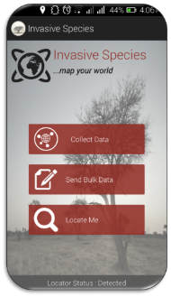
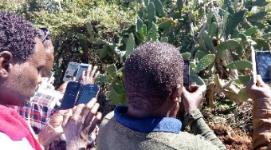
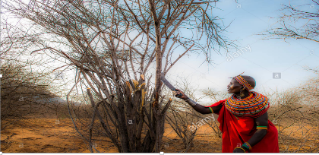
Land Cover, Land Use Change and Ecosystems
Mapping and Modelling Distribution of Invasive Plant Species
Problem specification
Kenya has had several invasions of alien species that have had negative impacts on biodiversity, agriculture and human development. The Northern Kenya Rangelands in the recent decades have experienced increased infestation by various invasive plant species; shrinking forage space available for both livestock and wildlife. Increased invasion will certainly exert a further strain on the shared natural resources (water and green pasture), thereby instigating un-ending human wildlife conflicts within such key biodiversity hot-spots. The local nomadic communities are likely to continue competing for limited pasture land a mid-climate change; this has been attributed to a recent conflict human wildlife conflicts experienced within Samburu – Laikipia regions.
Highlights
Figure 1, 2 & 3: An android application’s main page, a photo of rangeland coordinators collecting data using Invasive Species App and a member of the local community eradicating Acacia reficiens by cutting down.
Service Tracker
This service was identified through user needs assessment, followed by a series of consultations with the partners by holding technical exchanges. The service concept document has been developed and reviewed; other related documents are currently being filled ane are on track.
1
2
CNA/S
SC
PDD
TDD
DSDD
Goal
This service focuses on mapping and modelling current and future distribution of Acacia reficiens and Prickly Pear within the larger Samburu - Laikipia region. Identifying areas of invasion – hotspots; is extremely useful in prioritizing and planning of the conservation areas. Such information is central in controlling the spread and mitigating the impact of biological invasions. The data collected and maps developed through this service will help the stakeholders in allocating both financial and human resources in invasive plant species eradication plans.
3
Selected Indicators / Metrics
Indicators | Numbers
Number of people trained in sustainable landscapes supported by USG assistance | 68
Number of institutions with improved capacity to address sustainable landscapes issues as supported by USG assistance | 7
Number of SERVIR data layers standardized and made available in data portals. | 3
Number of regional stakeholders co-developing climate mitigation and/or adaptation tools, technologies, and methodologies | 2
Key stakeholders
Decision makers: National & County Governments, Conservation Organizations
Users: Northern Rangeland Trust, Laikipia Wildlife Forum, Kenya Wildlife service
Beneficiaries: Norther Rangeland Trust, Laikipia Wildlife Forum, Kenya Wildlife service
Special audiences: Local communities (Grazing committees)
Theory of Change
Assumptions:
Availability of funds & skilled staff, Cooperation from the partners, Data availability
Inputs:
Stakeholder engagements , Desktop reviews, Field data collection,
Acquisition and processing of EO, Bioclimatic and GIS data,
Technical exchanges, o-development and Data dissemination
Outputs:
Datasets – Invasive plant species occurrence data, and predictors variability data, Detailed technical reports, methodology & publication, Maps of current and future distribution of A.reficiens and Opuntia species, Training programs/Materials, Mobile application for data collection, Digital database.
Outcomes:
Increased provision of user-tailored geospatial data on invasive plant species occurrence, predictors variability and maps of current and future occurrence of invasive species.
Improved capacity of NRT, LWF and KWS to use data on distribution of invasive species to make decisions on resource allocation and mobilization to manage and eradicate invasive plant species.
Impact:
Reduced spread of invasive plant species.
Earth Observations / Models / Methods
This service highlights the use an android based application “Invasive Species App” in crowdsourcing training and validation data in mapping and modelling invasive species through involvement of the local communities. We use correlative Species Distribution Models (SDMs - Maxent) to estimate the current potential distributions of invasive species using occurrence records from native range, with a projection of the models into new regions to assess susceptibility to invasion.
Immediate Next Steps
Data collection, Maps Development ,Capacity Development and Data dissemination.
Looking forward
SERVIR E&SA plans to scale up the service from sub-national to national level through stakeholder consultations, partnerships and collaborations.
Contributions from AST
No direct link to this service

