Slide 1
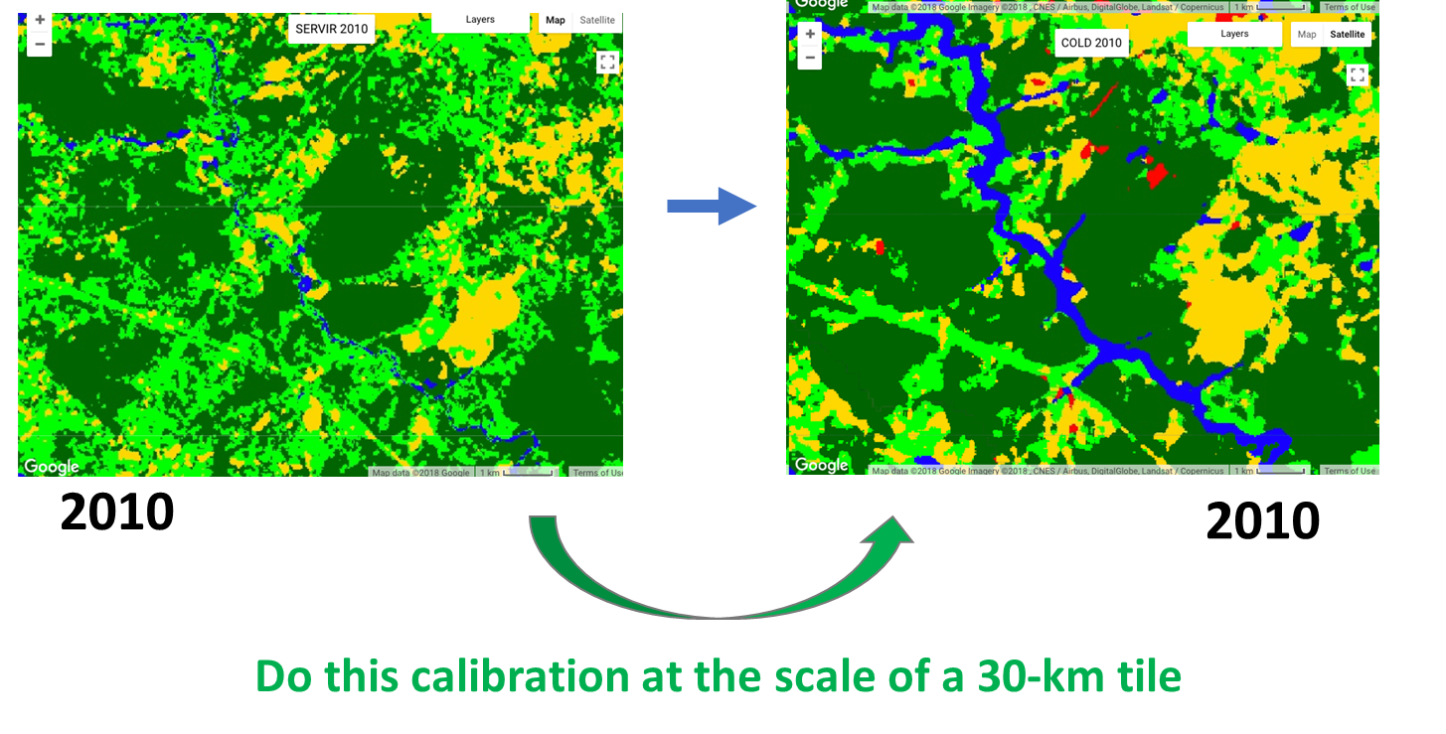
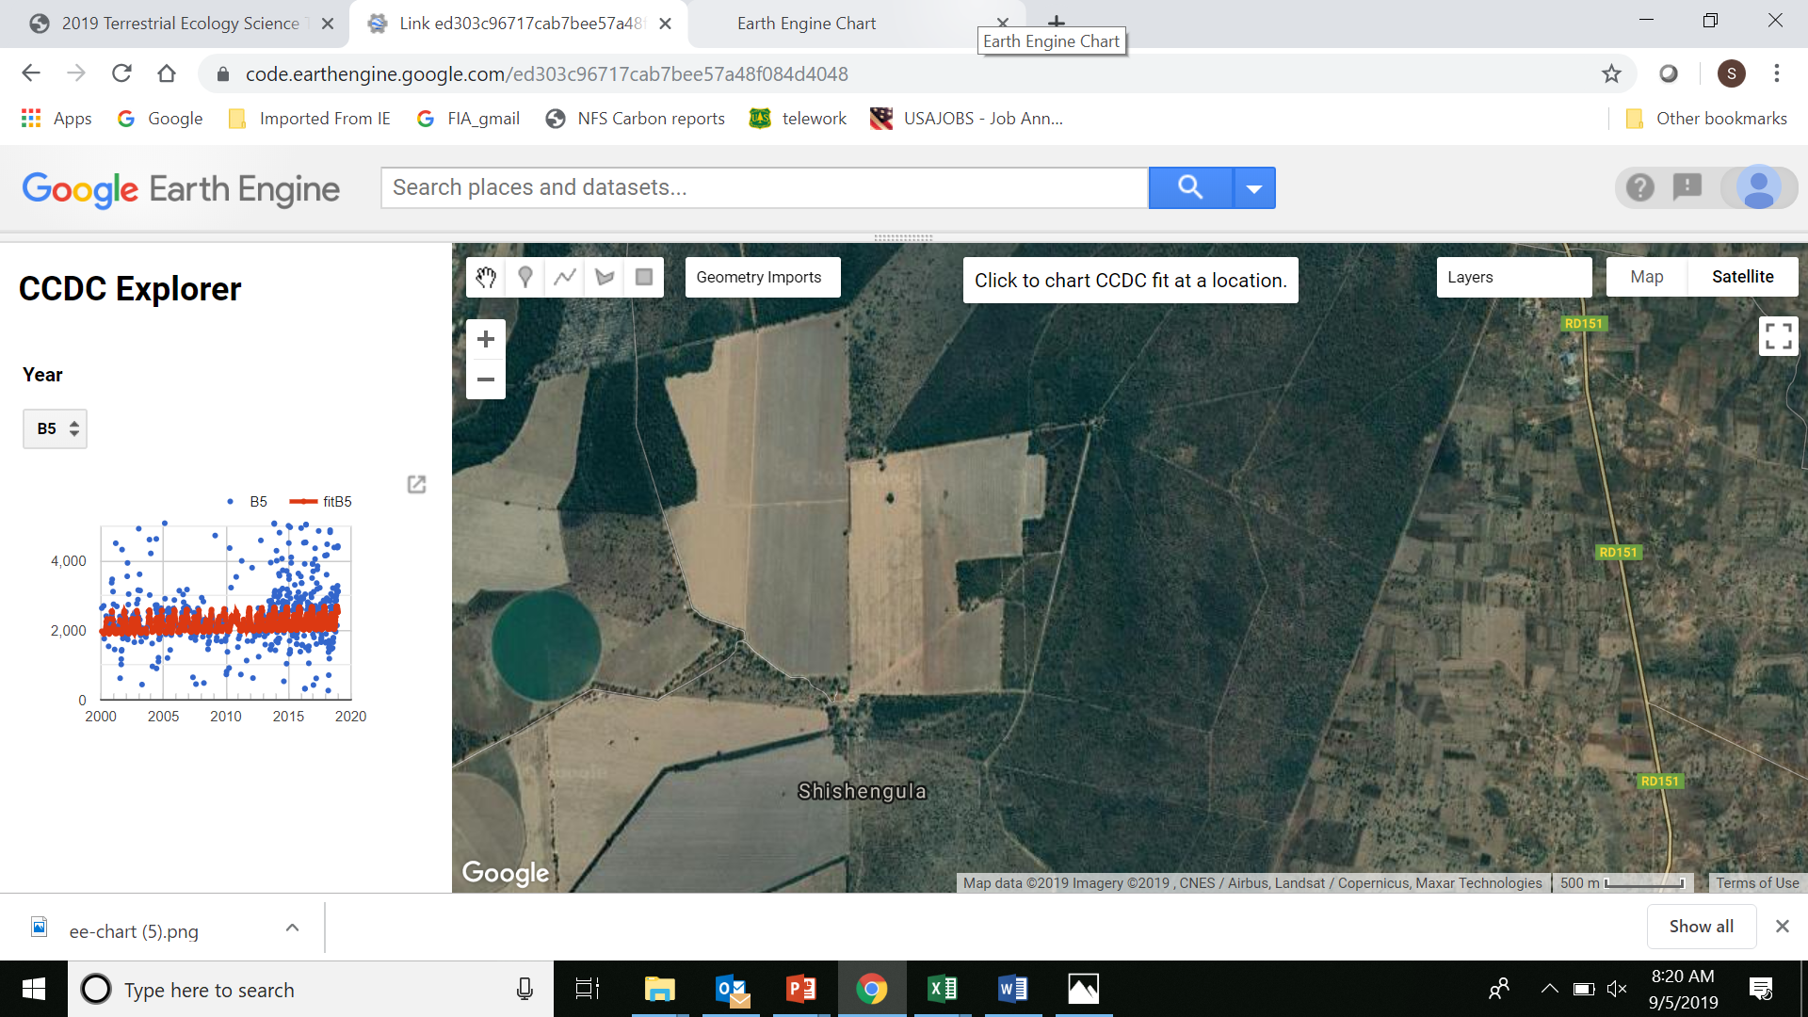
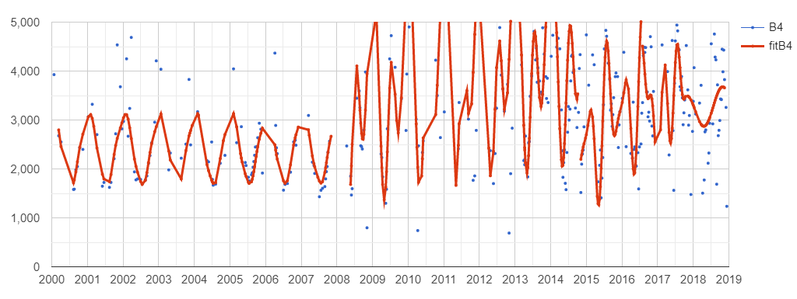
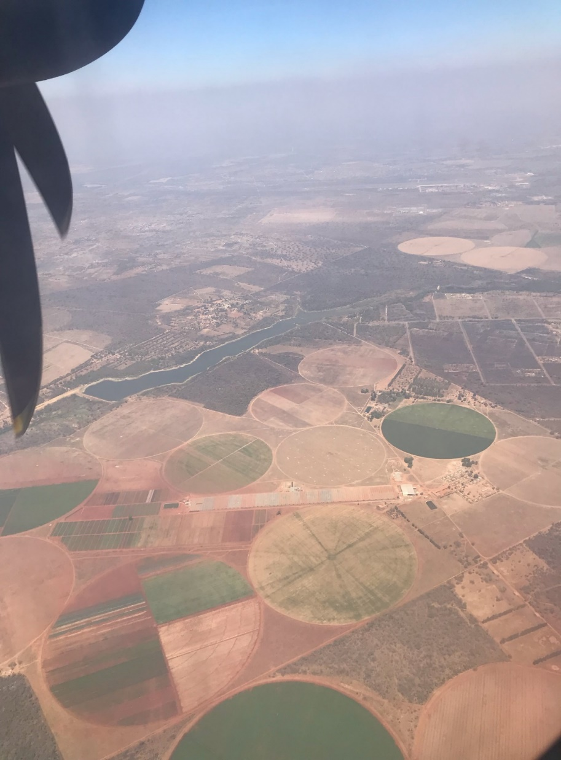
Land Cover, Land Use Change & Ecosystems
Enabling Annual Land Cover Mapping in the E&SA Region
Training
Beta Testing
Consultations
Fieldwork
Operationalization
Needs Assessment
Stakeholder Mapping
Service Planning Dev.
Consultation/Needs Assess.
Output 1
Outcome A
Problem specification
The reliance on land use land cover and change information has been crucial in development of: National and sub-national development plans, national forest reference levels that provide baseline data on the state of forest, reporting of anthropogenic greenhouse gases emissions to the UNFCCC, providing indicators and proxies for SDGs, determining the state of environment, ecosystem valuation, land degradation assessments and in development of sound policy relating to management and/or conservation of natural resources.
The availability of periodic, timely, reliable and accurate data to address these issues has been challenging to come by. Capacity of different stakeholders in developing the required datasets to address these needs is still insufficient. Furthermore, the region lacks guidance on appropriate methods and national/international standards to use when developing LC products.
Use Case / Highlights
Highlights:
Use Case
World bank request from Madagascar for deforestation data;
Tullow oil to monitor water demand through vegetation changes;
Request from Zambia data to support for conservation efforts;
Student researcher who determined with much more clarity the changes in his area of study in Rwanda and adopted CCDC in his thesis;
Impacts of the new dam around the Nile river clarified during one of the visits in Ethiopia. There was signification changes in vegetation downstream after the dam construction.
Selected Indicators / Metrics:
CCDC accessible as open source in all the project countries;
Refined data released and made accessible to the counties;
Increased uses cases;
Project publication (in progress): “Merging global and local assets for improved land cover monitoring” (co-authors will include AST and Hub personnel).
Theory of Change
To Achieve Sustainability
Assumptions:
Key stakeholders continue to use, share and disseminate data and utilize the knowledge and skills gained ultimately leading to better decision making processes.
Inputs:
Consultations and stakeholder engagements;
Reference data collection;
Methodology, tool and data development;
Capacity building of hub and regional stakeholders;
Monitoring and evaluation, stakeholder mapping and dissemination.
Outputs:
Statistical estimates of the land cover transitions;
Annual land cover data;
Dissemination platform;
Reference data;
CCDC access for all project countries;
TimeSync tool;.
Outcomes:
Increased provision of user-tailored geospatial data and land cover and change data to inform decision making;
Improved capacity of forest, environment ministries and conservation agencies and to determine and report on status of forests.
Impact:
Improved capacity of stakeholders to make policy decisions on management and conservation of land resources.
2010
2011
2012
2013
2014
2015
Goal
The main objective for this service is to build relevant capacity and data products through stakeholder consultations and ensure that their data and training needs are met. We leverage partnerships to develop annual products and tools that are used to ease evidence based decision making processes by making the data and tools easily accessible.
Consistent Mapping achieved with Time Series using CCDC to detect the changes
Key stakeholders
Decision makers: Rwanda Land Management and Use Authority (RLMUA), Geospatial Information Institute Ethiopia, National Forest Service, Uganda, Department of Forestry, Zambia, Department of Resource Surveys and Remote Sensing, Kenya and Kenya Forest Service, Vice President’s Office, Tanzania, Department of Forestry, Malawi.
Users: Ministries of Natural Resources and Forestry, International Organizations, Universities, Climate Change Agencies/ Units, REDD+ programs, Climate change, International Community, Researchers and Development Partners such as World Bank.
Beneficiaries: Community.
Links to Maps
Ethiopia
Kenya
Malawi
Rwanda
Tanzania
Uganda
Zambia
Google sites created to enhance data access to all materials from 8 workshops
GEE Visualization Platform
Science Collaborations, Earth Observations, Models, and Methods
Contributions from AST
This particular project was co-developed with the AST with Sean Healey as the PI, SERVIR ESA, USGS, and Google Inc. as the Co-I’s. National stakeholders provided input for reference data and feedback on outputs. They also participated in all training and dissemination events. In May and September we held a series of dissemination activities in the countries to release the preliminary results.
Earth Observations / Models / Methods
Statistical estimation of land cover change is using reference data collected through the TimeSync tool (Cohen et al., 2010) to determine land cover transitions across the 7 project countries. TimeSync uses time series of Landsat data.
Further, annual land cover maps were developed within the Google Earth Engine using Landsat data and relying on Continuous Change Detection and Classification (CCDC) algorithm to detect changes over the time series. The Random Forests algorithm is used to classify individual land cover. The consistency of outputs is much more realistic since change in land cover is only recorded when CCDC detects change. Previously developed LC data for the countries are also used to gap-fill training data for the map production.
Immediate Next Steps
Collect more feedback and training data for map improvement;
Increase data access;
Make CCDC accessible;
Publication;
Looking forward
More utility cases and success stories.
CCDC used to show new agricultural areas and confirmed using high resolution imagery

