Slide 1
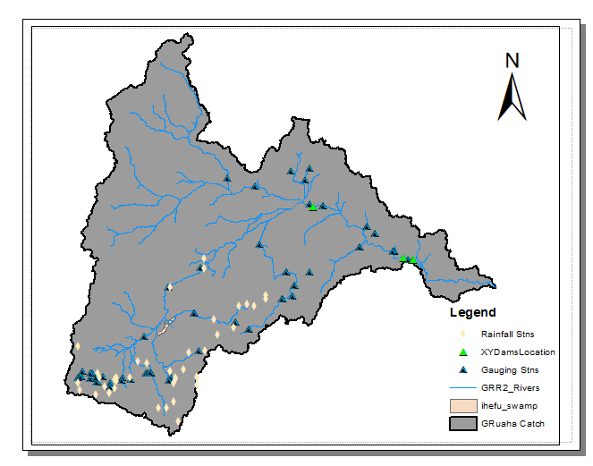
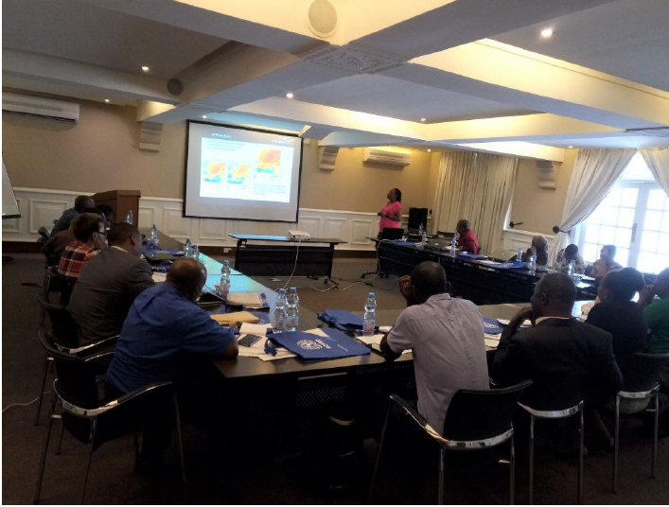
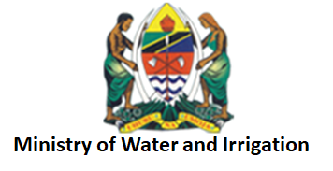
Water & Water Related Disasters
Regional Stream Flow Monitoring and Forecasting
Consultations
Training
Beta Testing
Operationalization
Needs Assessment
Stakeholder Mapping
Service Planning Dev.
Consultation/Needs Assess.
Stakeholder training
Outcome A
Problem specification
Eastern and Southern Africa regions face issues related to too much and too little water.
As much as these issues are associated with natural phenomena like rainfall variability
and rising temperatures, these are also made worse by institutional policies currently in place in the water sectors. Furthermore, the paucity is attributed to the existence of weak water resources monitoring networks which is linked to inadequate human skills and capacity in the collection, assessment and dissemination of data on water resources for evidence-based water resources planning, development and management. Tanzania has nine river basins and the problem of water un-availability is affecting most of these river basins. On a broader perspective, the problem of water un-availability in Tanzania is being contributed by both climatic and non-climatic factors.
Use Case / Highlights
Service Use Case:
Selected Indicators / Metrics:
Theory of Change
To Achieve Sustainability
Assumptions:
Availability of quality in situ data for the calibration of the models
Forecast streamflow data will correctly predict and forecast river flows
Key user (MoWI) will utilize forecast streamflow data for timely decisions.
Key users will provide timely feedback on stream-flow forecast data
Inputs:
Data
Software and Hardware
Skilled human resource
Funds
Outputs:
Stakeholders trained
Scripts developed
Processed data
Calibrated models
Stream-flow forecasts
Customized platform
Training manual
Outcomes:
Improved capacity of key users (MoWI, TANESCO) to use forecast streamflow data to make decisions on water allocation and reservoir management
Forecast streamflow data shared and disseminated by key users
Forecast streamflow data hosted by MoWI
The Great Ruaha region experiences severe weather occurrences. Information on rainfall and water availability is very important for the communities that make a living within the catchment. “Monitoring has become a very expensive business and many institutions require such information for decision making” remarked the Director of Water Resources in the Ministry of Water and Irrigation during a consultations workshop.
Having data and information on streamflow will help the Ministry and water users to make decisions related to water abstraction from the rivers, water needs for irrigation and catchment conservation. They will also be able to monitor and mitigate any potential flood occurrences along the river basin.
Photo/Image
Goal
Key stakeholders such as Tanzania Ministry of Water and Irrigation, Rufiji Basin Water Office and Tanzania Meteorological Agency (TMA) are mandated to monitor water resources use, planning and conservation and to provide accurate and reliable information to the community on a timely basis. Therefore, the main goal is to develop sustainable solutions in collaboration with the key stakeholders which will involve co-development of geospatial datasets, products and hydrological modelling tools to fill data gaps, increase the timeliness of information and dissemination and improve on water resources management practices.
Activities:
Stakeholders consultations
In situ and satellite data collection and analysis
Methodology (modification of scripts)
Calibration and validation of the models
Customization of the web-based platform
Capacity building of the stakeholders
Impact:
Improved efficiency in water management
Improved policy on water management
Increased water access to beneficiaries
Key stakeholders
Decision makers: Ministry of Water and Irrigation( MOWI), Tanzania Electric Supply Company Limited (TANESCO)
Users: MOWI( TZ), TANESCO
Beneficiaries: Water Users Associations, Local communities, TANESCO, Zonal Irrigation Office, Research institutions, urban water supply bodies (Great Ruaha catchment), Ministry of Agriculture, Livestock, Fisheries and Cooperatives
Stakeholder workshop in Tanzania
Number of people trained in climate change adaptation supported by USG assistance | 28
Number of institutions with improved capacity to address climate change issues as supported by USG assistance | 3
Number of data agreements developed/created with USG assistance | 1
Number of regional stakeholders co-developing climate mitigation and/or adaptation tools, technologies, and methodologies | 2
Immediate Next Steps
Completion of calibration of the VIC model will be done in collaboration with SCO.
Development of a back-end of the SWAAT platform for the visualization of the new products.
Technical training on the use of the tool and the products including how to create some of the datasets in a GIS environment.
Looking forward
SERVIR-E&SA will engage MoWI to host streamflow forecasts platform, work with key users to include stream-flow forecast data as an agenda in the existing technical working group and link users with geospatial networks for continuous capacity building.
Assessing the capability of linking the Streamflow Model outputs to the existing Rufiji Decision Support System (DSS). Rufiji Water Board has provided the Rufiji DSS technical manual for further reference.
Science Collaborations, Earth Observations, Models, and Methods
AST Contributions: Co-development of tools and methodologies, Training workshops
Beginning ARL:5 Current ARL: 6 Final ARL: 9
Earth Observations / Models / Methods
The service will leverage on tools and methodologies developed in collaboration with researchers within the SERVIR network such as AST-1 (Juan Valdes) and AST-2 (Yang Hong), and replicated to pilot basins (Great Ruaha in Tanzania and Nzoia basin in Kenya). A multi-model, multi-product approach will be used to develop stream flow forecasts products which can be used by the key stakeholders to improve their water management practices. Geospatial data such as satellite precipitation products, topographical data and other hydro-climatic data will be used in the development of the stream flow forecast products.

